Slide 2
Using Doxygen for CPSS
September 2017

Slide 3
The main objective
Used documentation generator Doxygen, for writing CPSS API reference documentation. The documentation is written within code, and is thus relatively easy to keep up to date.
Generate documentation from source code
See: http://www.stack.nl/~dimitri/doxygen/
Downloads
See: http://www.stack.nl/~dimitri/doxygen/download.html
Documentation manual
See: http://www.stack.nl/~dimitri/doxygen/manual/index.html
Commands
See: http://www.stack.nl/~dimitri/doxygen/manual/commands.html

Slide 4
Update CPSS API for Doxygen
Change documentation commands in source code
Generate up to date User Guide
Update links in User Guide to CPSS API

Slide 5
Update current CPSS API documentation command to Doxygen command
(c), Copyright
copyright
File_XXX.h
file
typedef: enum
enum
typedef: struct
struct
Function
[]|fn
typedef: union
union

Slide 6
Update current CPSS API Function command to Doxygen
DESCRIPTION:
brief
APPLICABLE DEVICES:
warning APPLICABLE DEVICES:
NOT APPLICABLE DEVICES:
warning NOT APPLICABLE DEVICES:
IN
param[in]
OUT
param[out]
RETURNS:
Retval
COMMENTS:
note

Slide 7
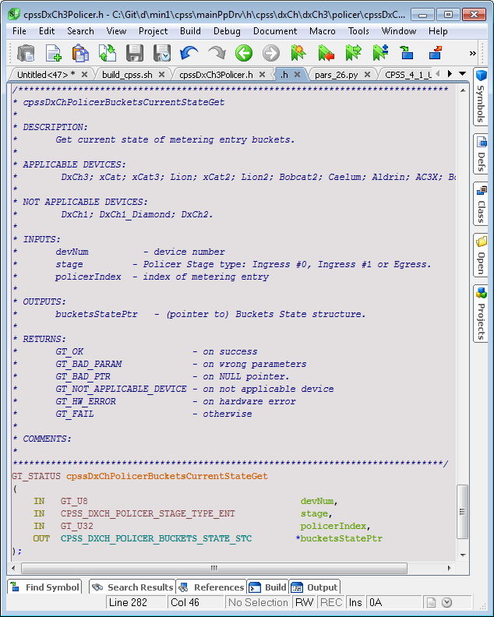
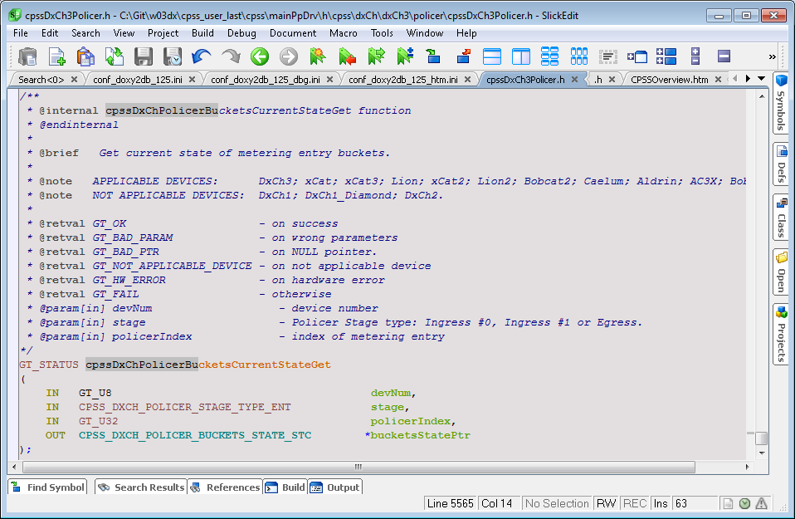
Change FUNCTION commands

Slide 8
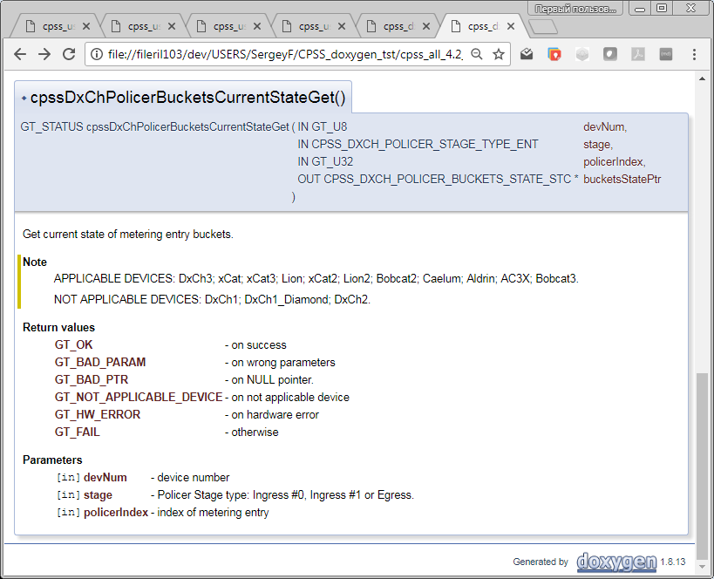
Doxygen

Slide 9
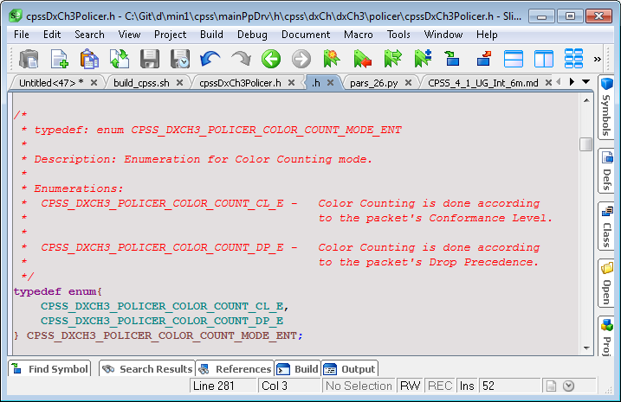
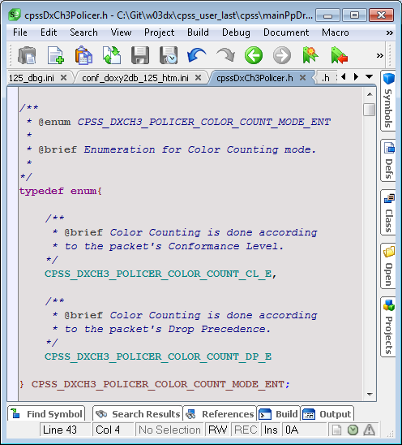
Change Enumeration commands

Slide 10
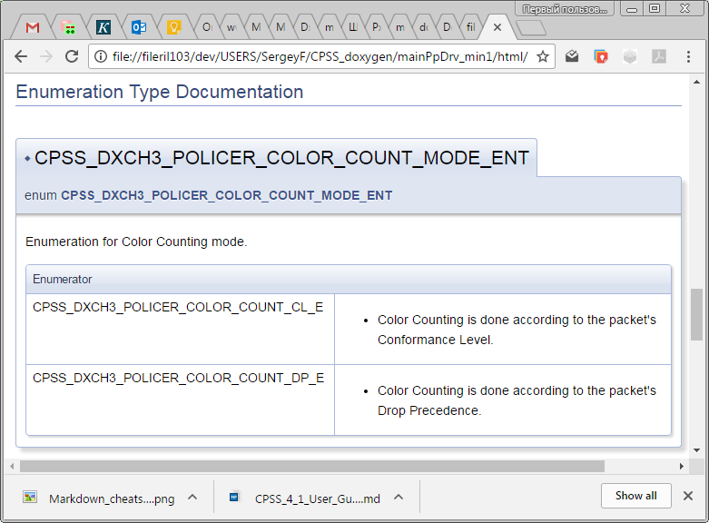
Doxygen

Slide 11
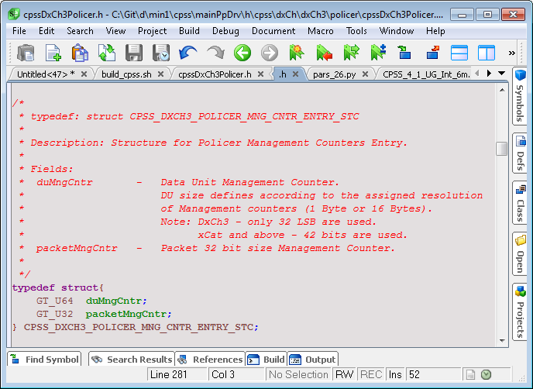
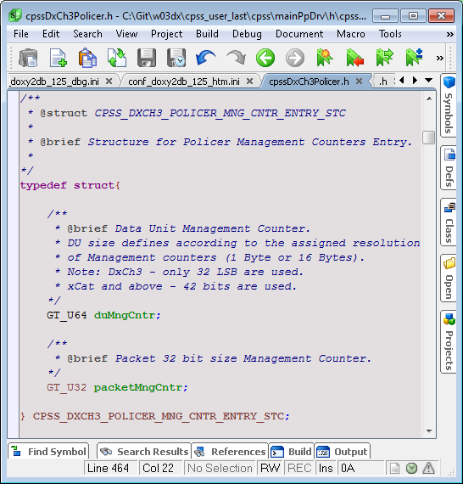
Change Structures commands

Slide 12
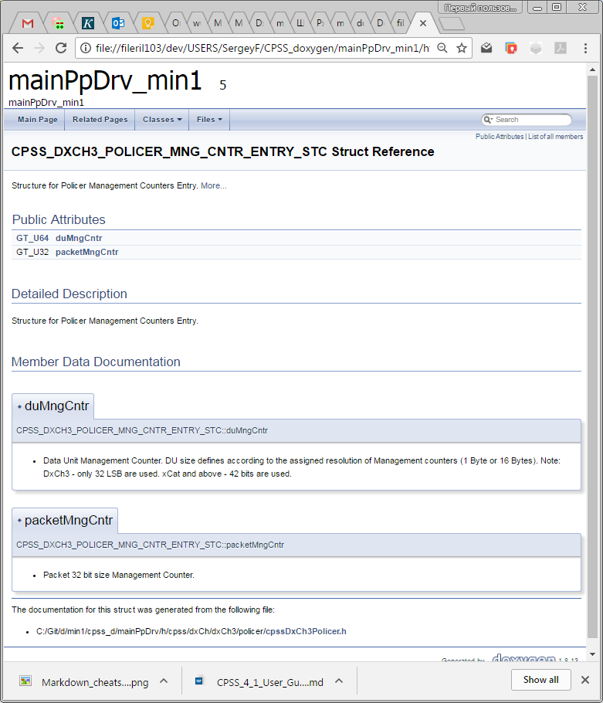
Doxygen

Slide 13
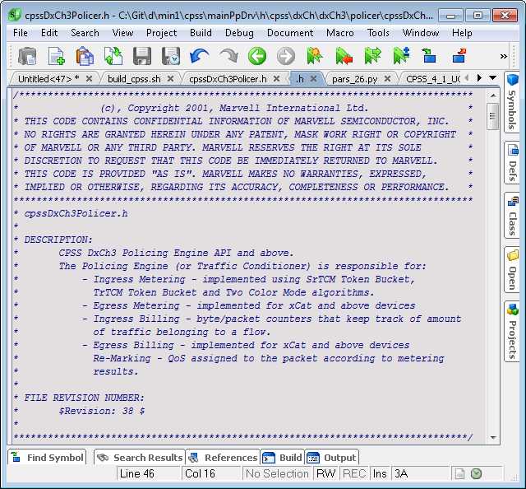
Copyright,File - before

Slide 14
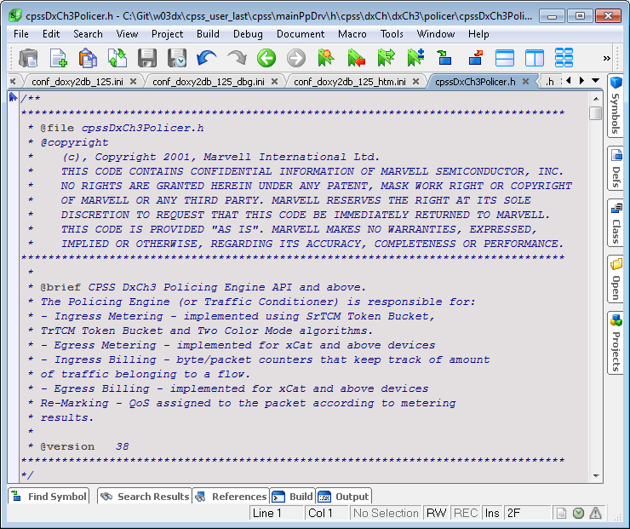
Copyright,File - after

Slide 15
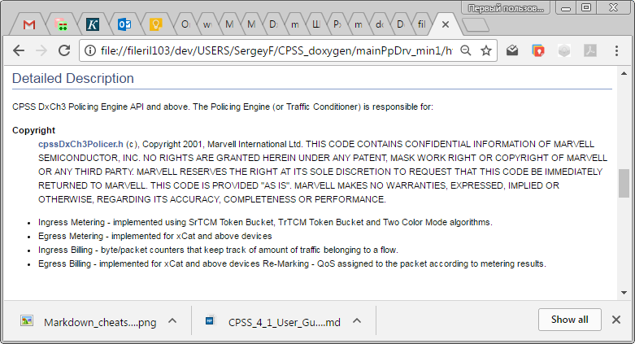
Doxygen html

Slide 16
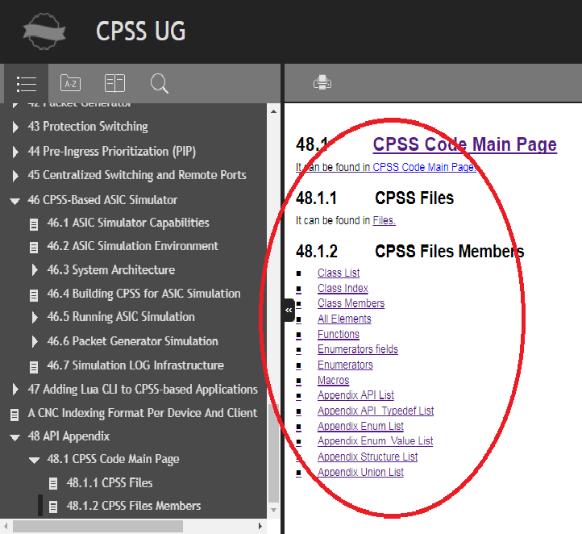
User Guide links to Doxigen

Slide 17
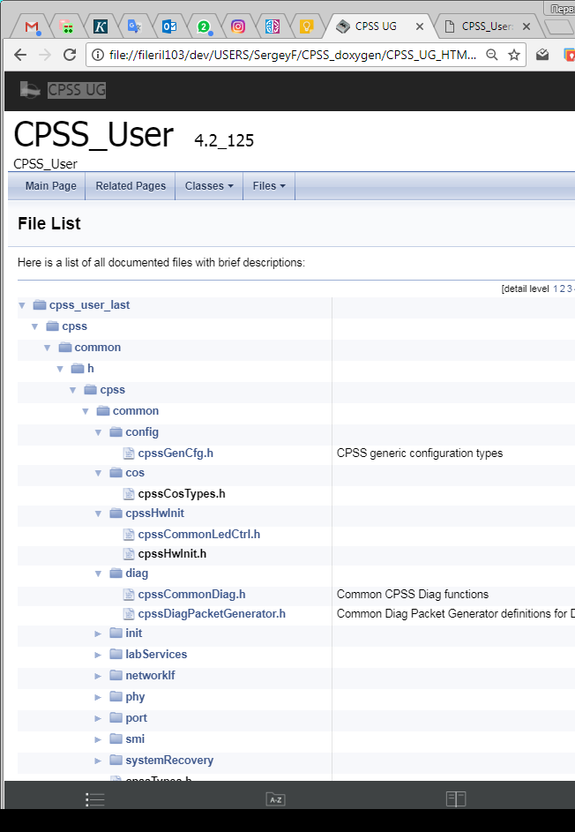
File List

Slide 18
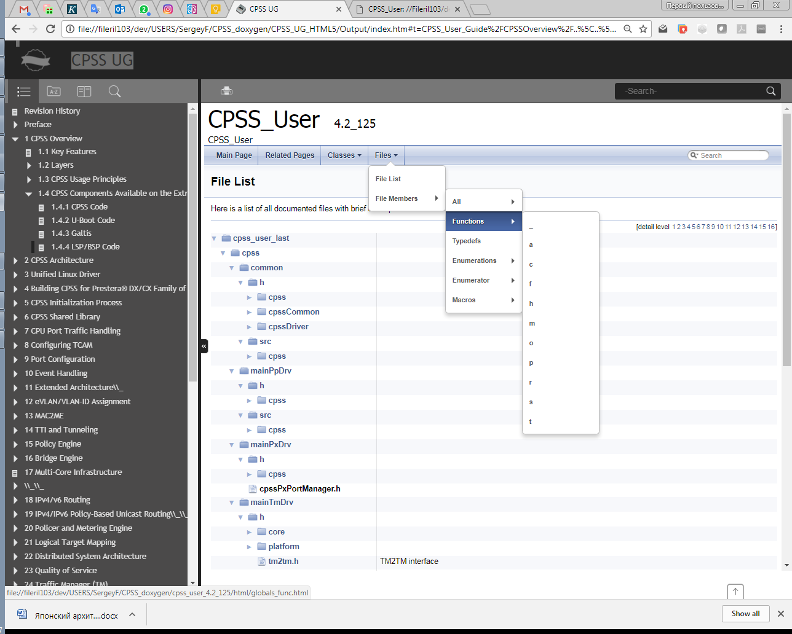
Functions

Slide 19
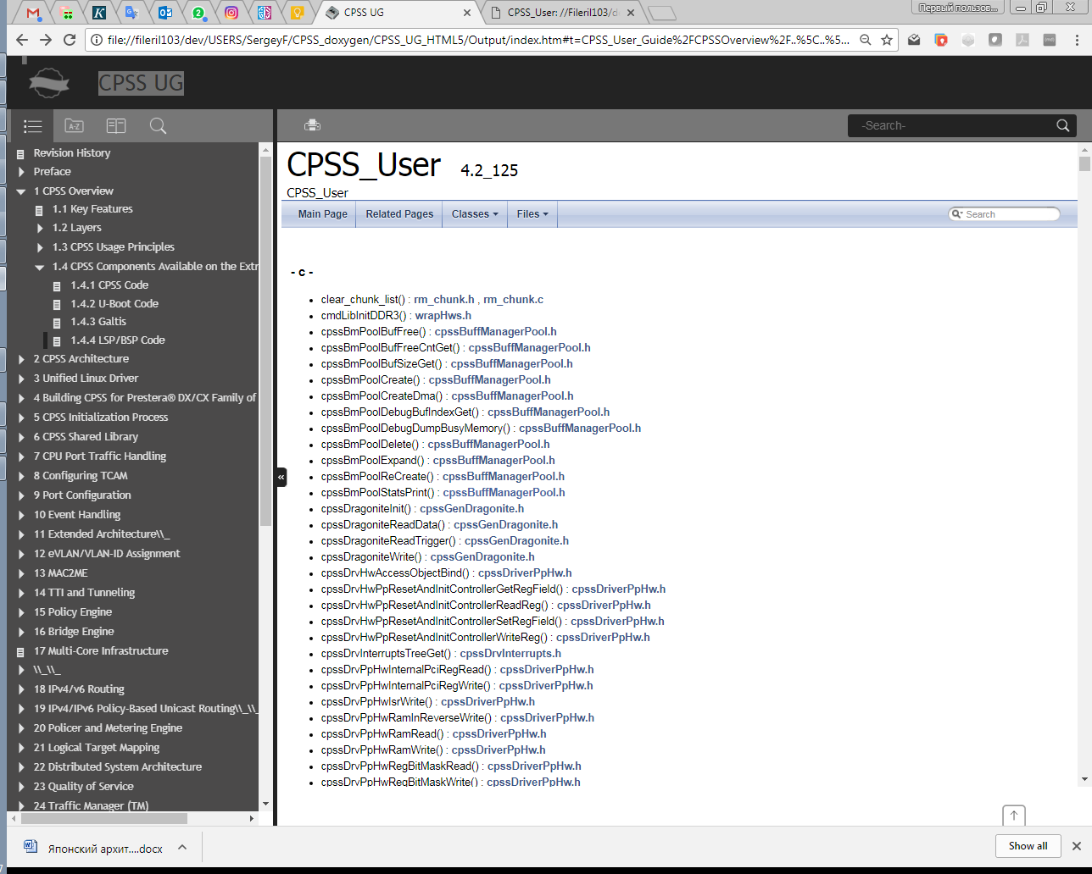
Functions list

Slide 20
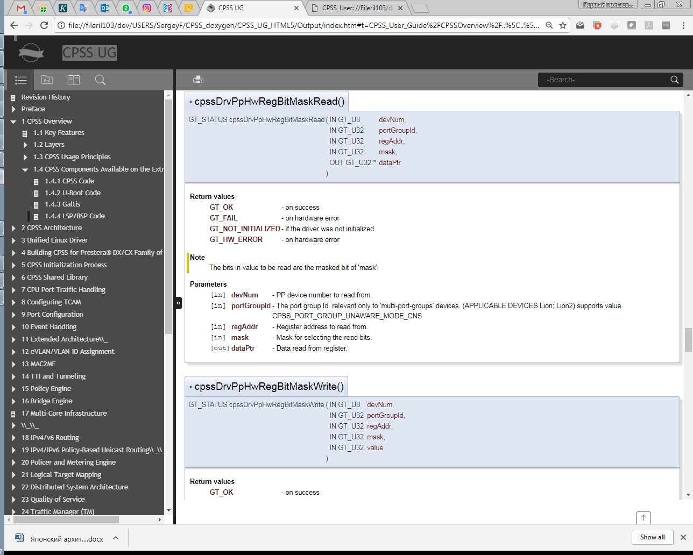
Function example

Slide 21
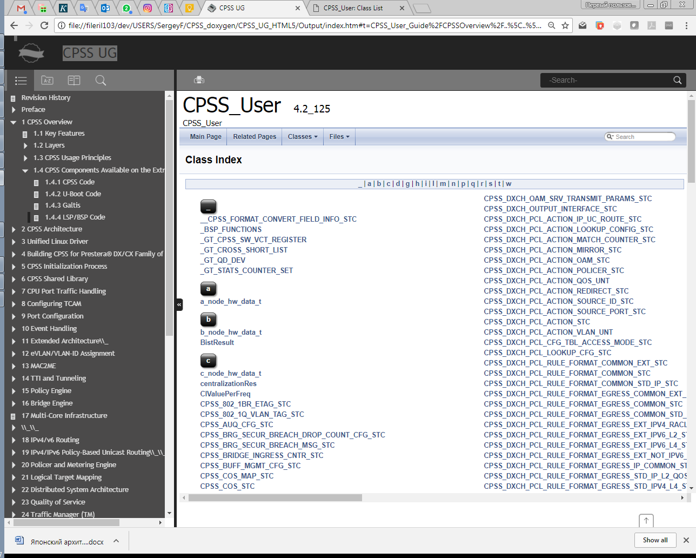
Class Index

Slide 22
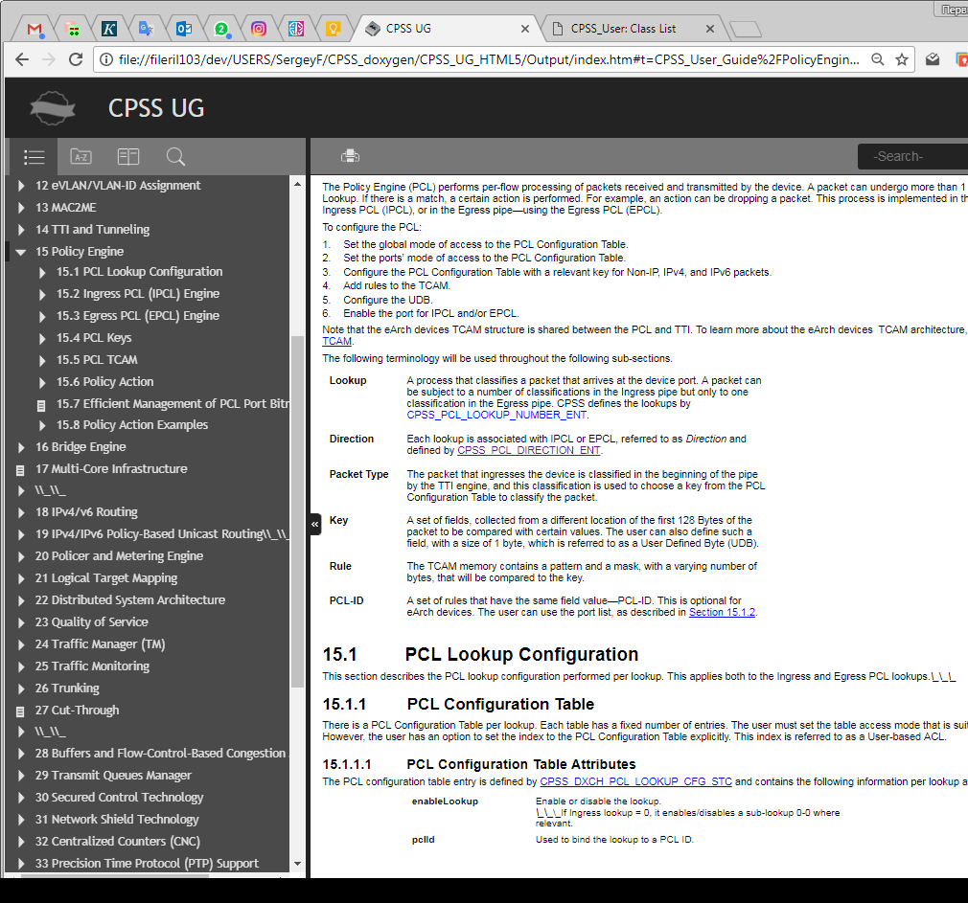
HTML User Guide with links to API

Slide 23
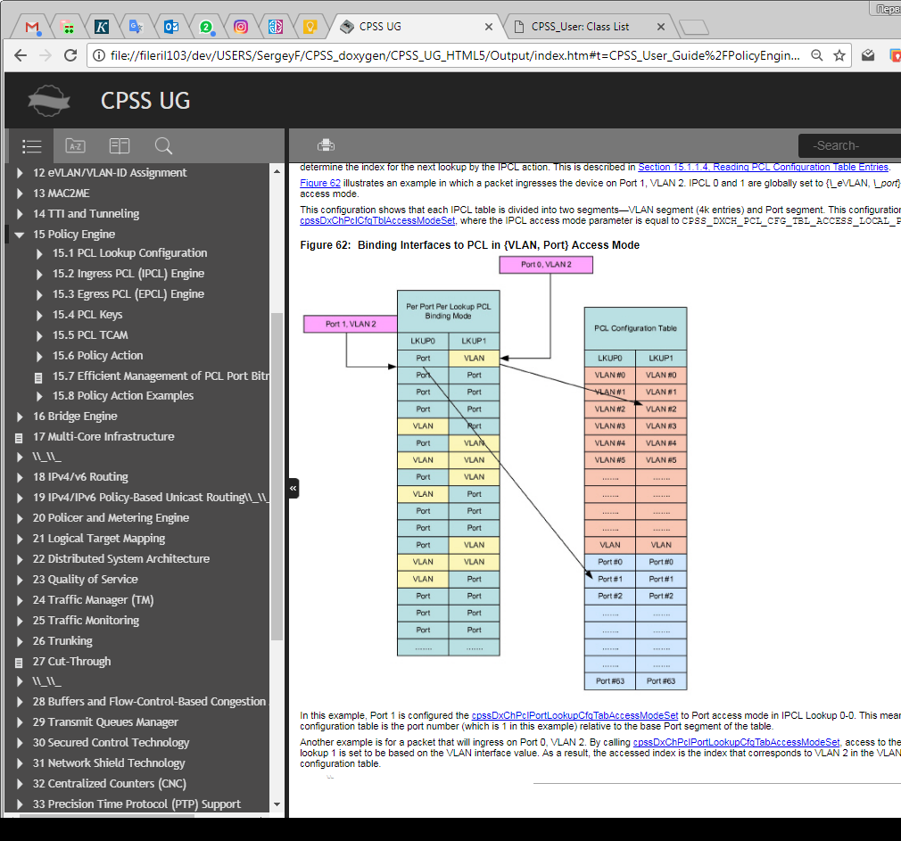
HTML User Guide with links figures

Slide 24
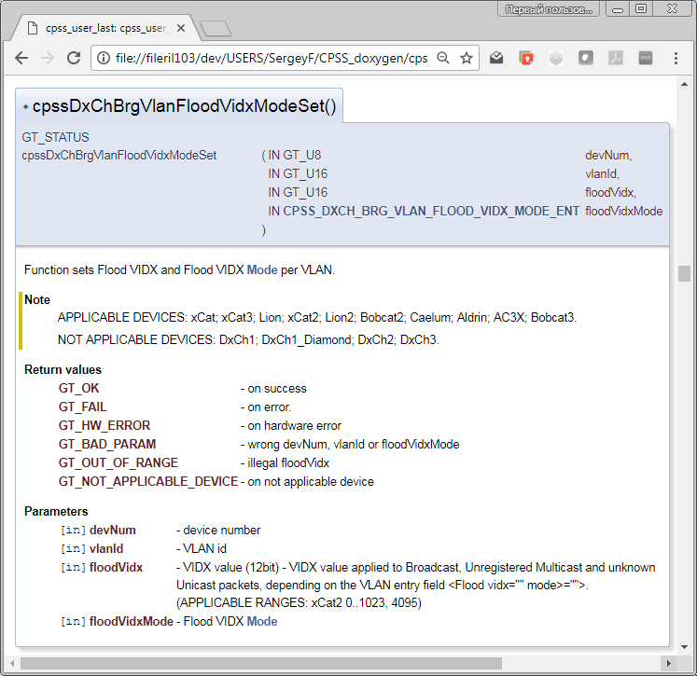
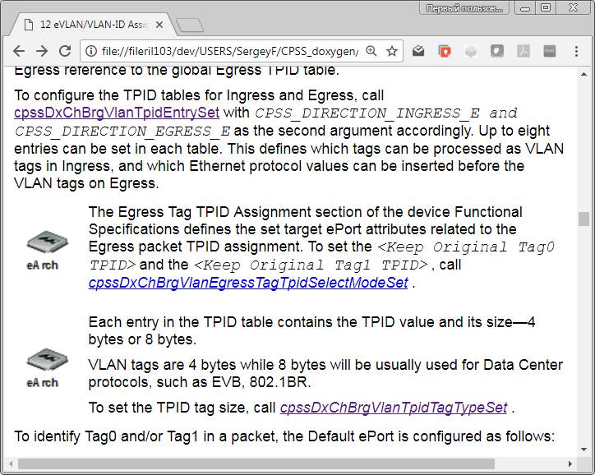

Slide 25
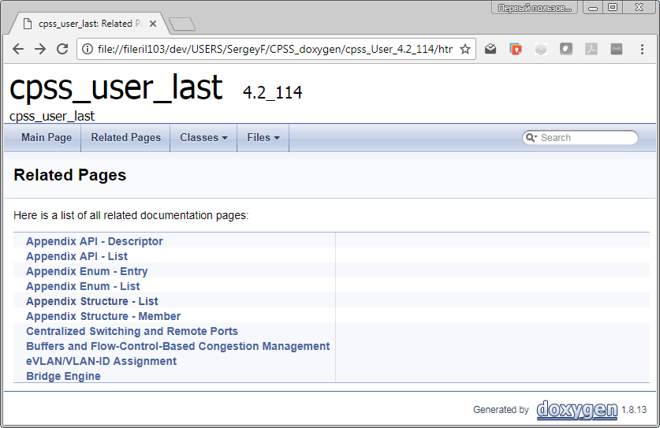
User Guide Related Pages

Slide 26
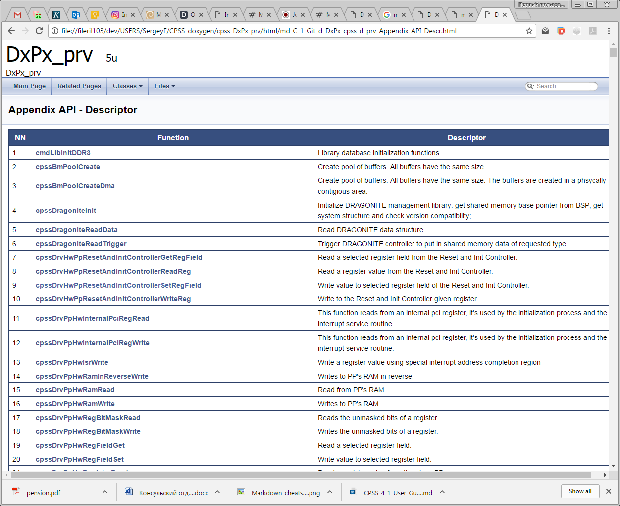
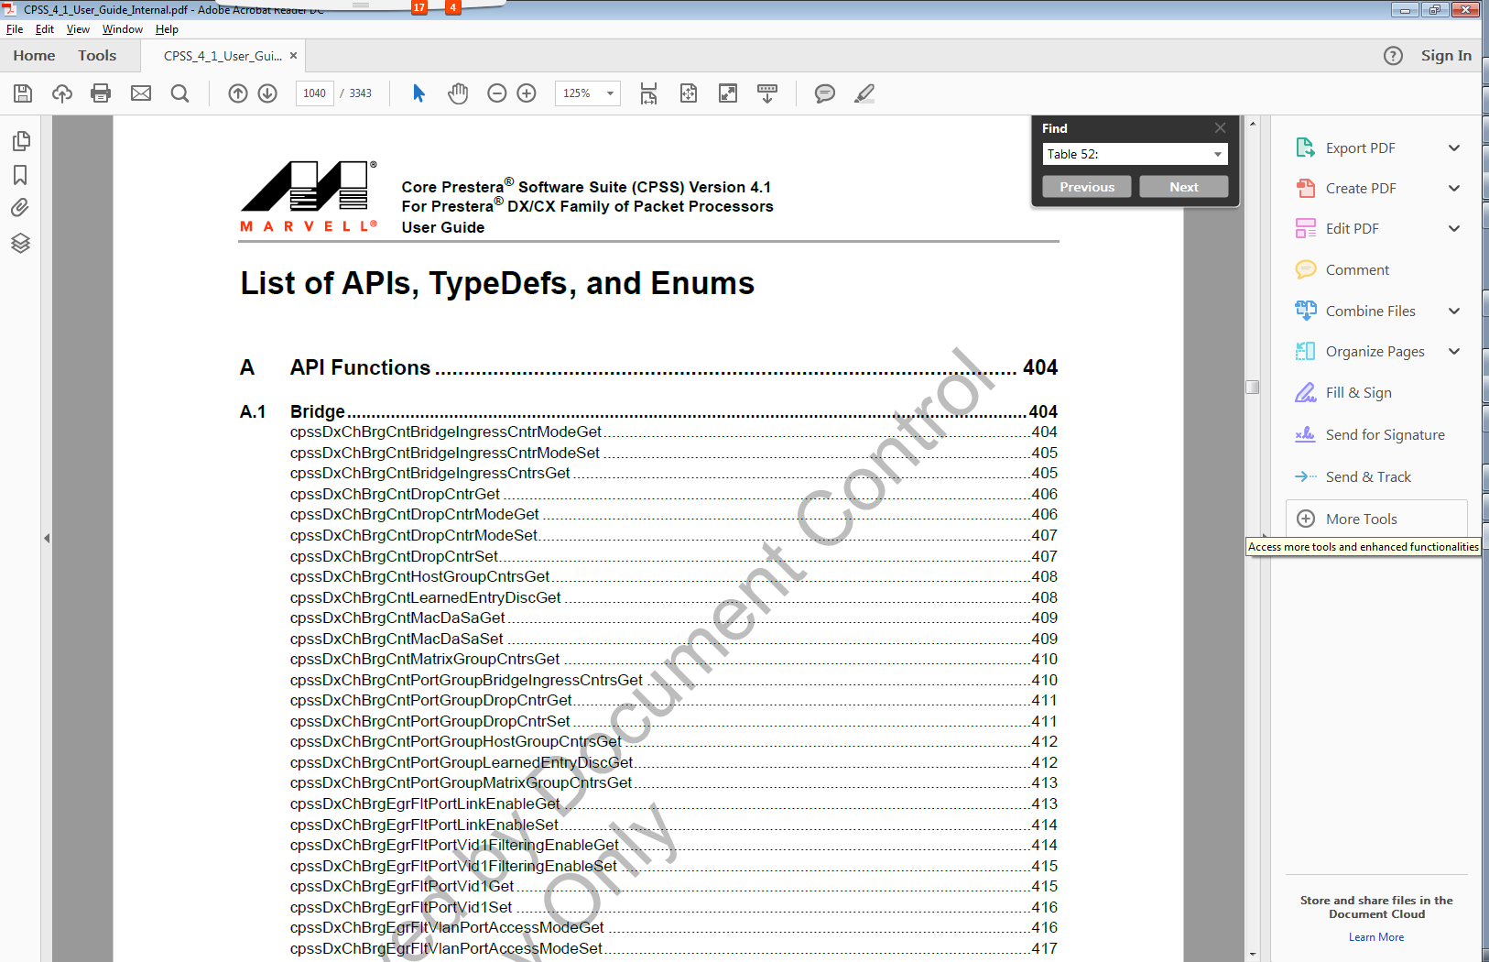
Up to date API Links

Slide 27
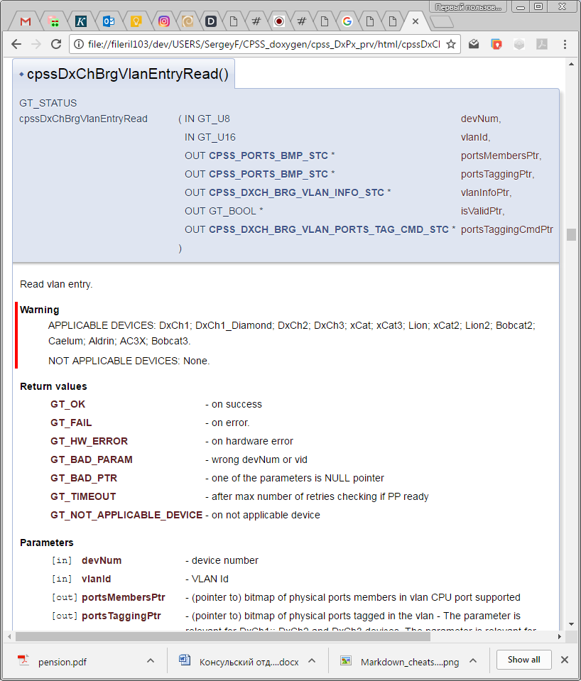
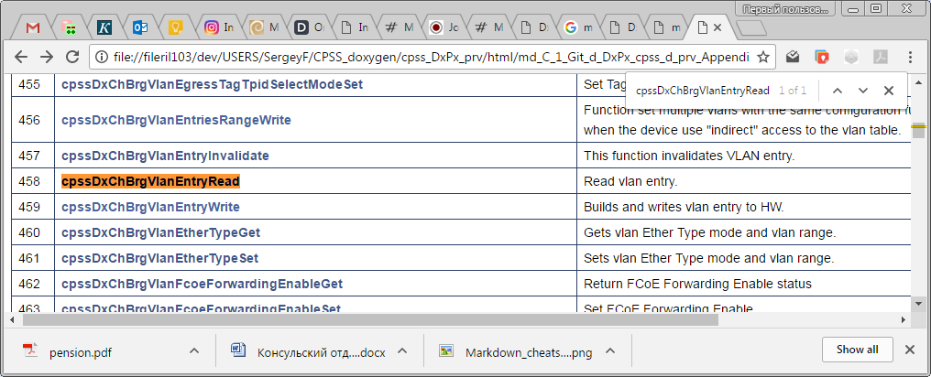
API Links

Slide 28
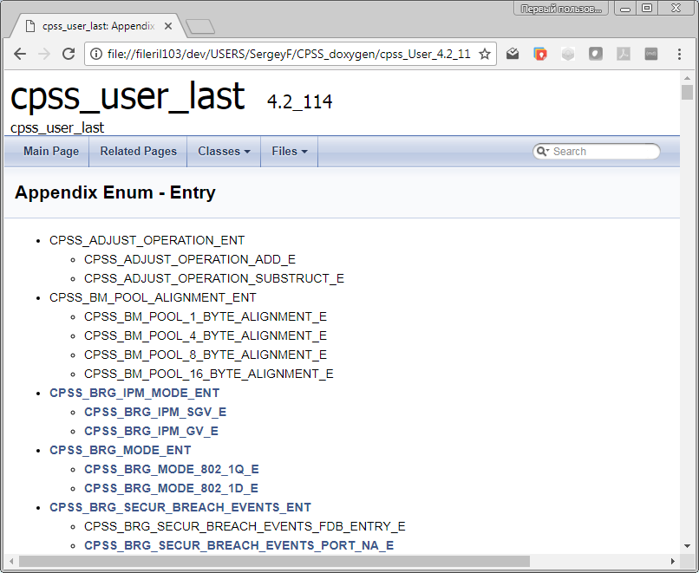
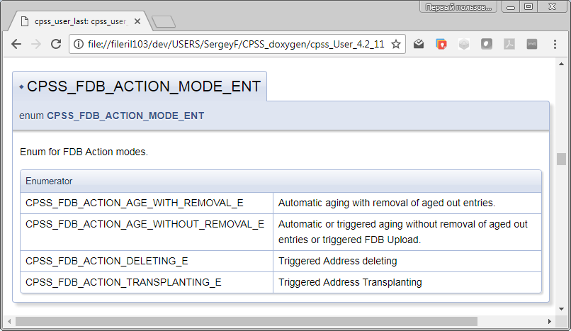
Appendix Enum - Entry

Slide 29
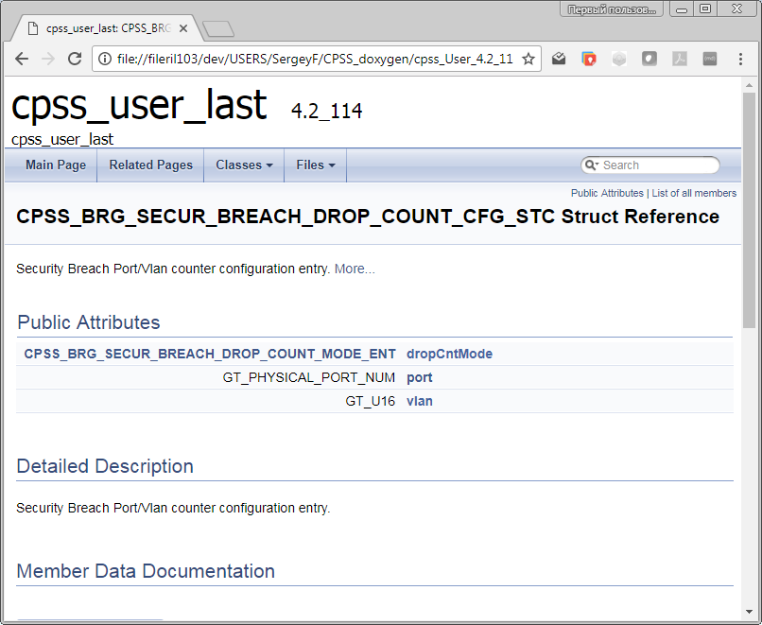
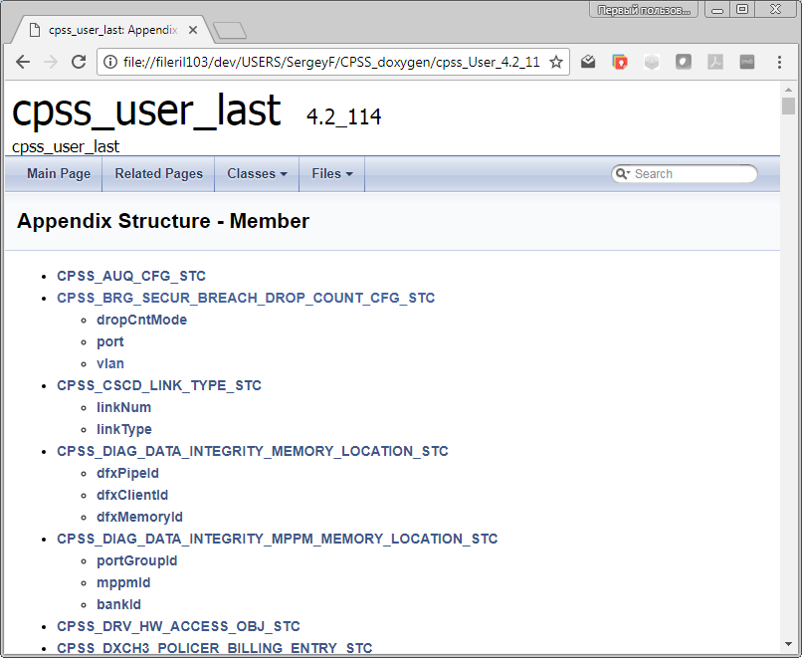
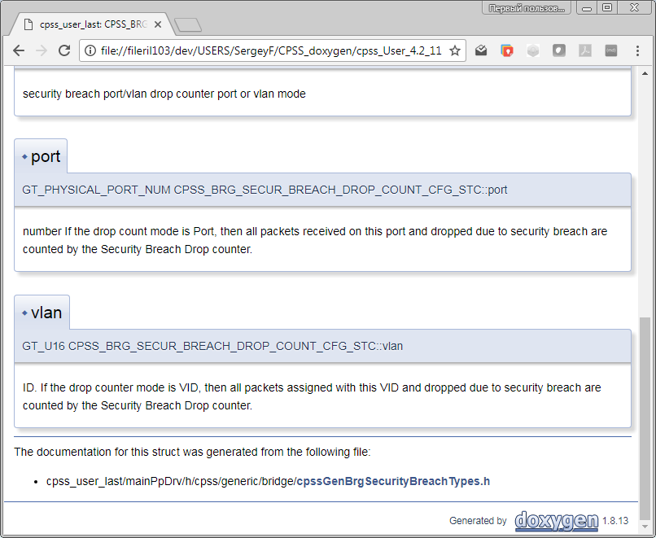
Appendix Structure - Member

Slide 30
Transform CPSS API to Doxygen documentation
Change commands in source code
Generate up to date User Guide
Transform User Guide to Markdown
Creating Main LUA Wrapper XML
Compare with old releases
Code clean up CS verification

Slide 31
Transform CPSS API documentation in Doxygen
User Guide text
Doxygen &
Source code

Slide 32
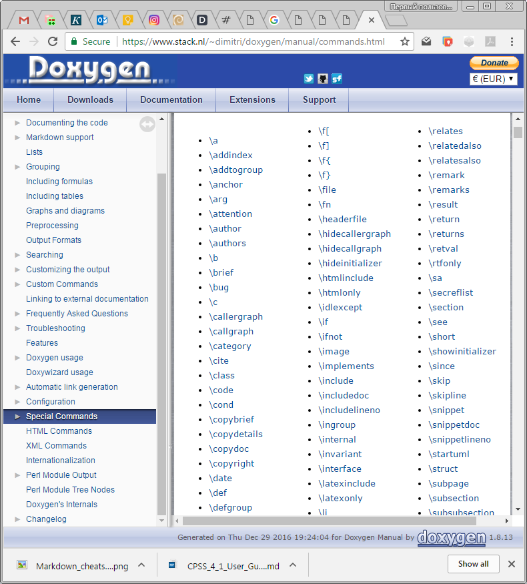
Used addition commands for CPSS API documentation in Doxygen
Commands
todo - paragraph describing what is to be done
see - references
example - <file-name>
bug - description

Slide 33
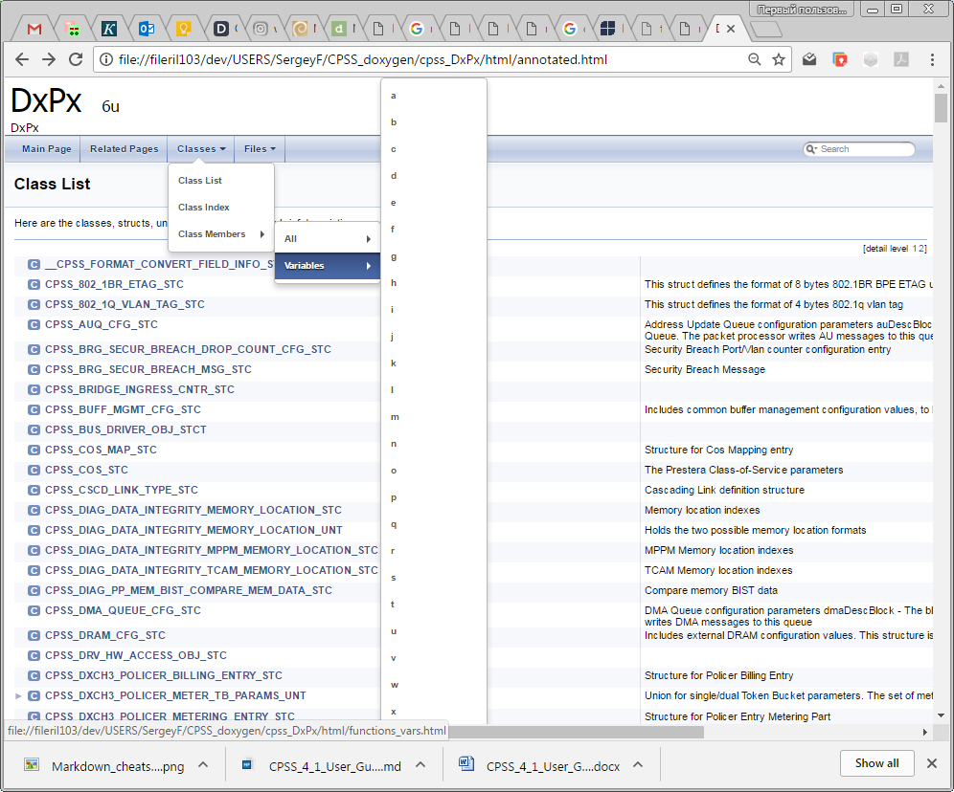
Using all opportunities of Doxigen

Slide 34
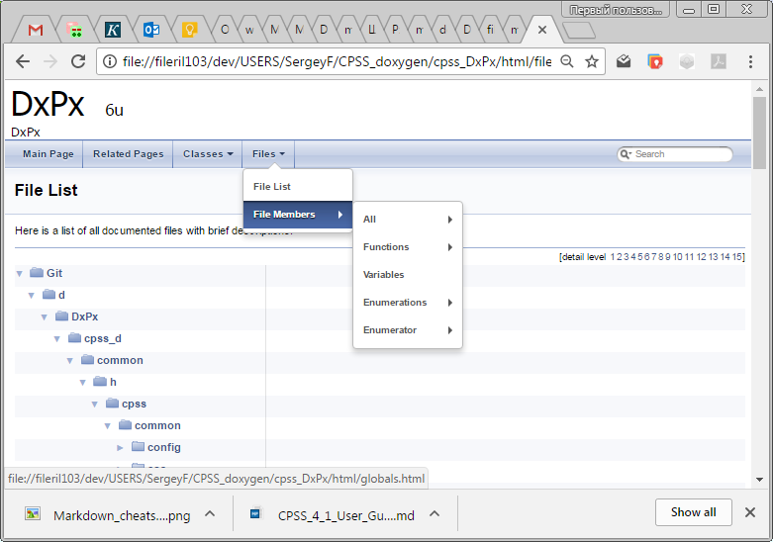
Using all opportunities of Doxigen

Slide 35
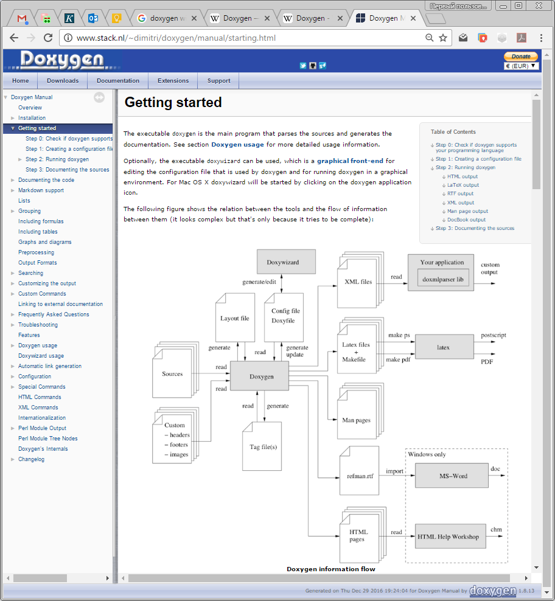
Using all opportunities of Doxigen

Slide 36
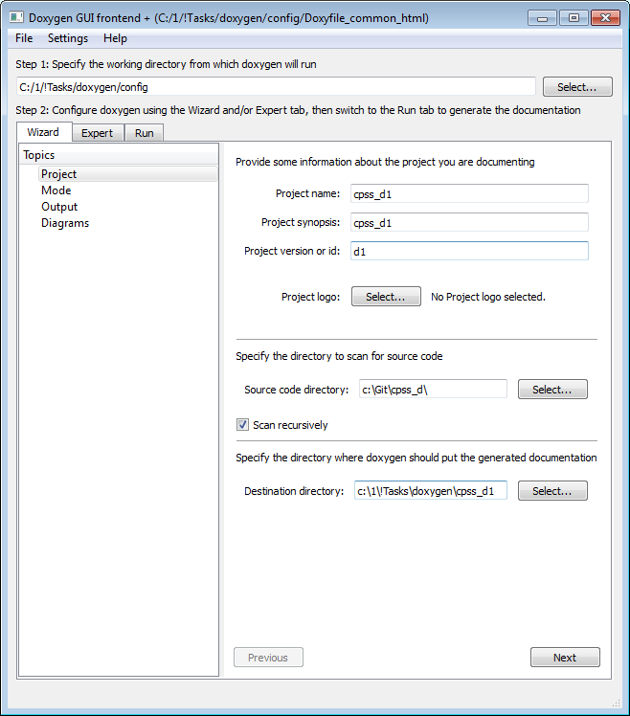
GUI DoxyWizard

Slide 37
Thank You!

